Slide 1
Logistic Regression

Slide 3
Linear regression slopes can be much larger than 1 and much smaller than zero, making it difficult to use them for classification tasks as thresholding becomes tough.
In logistic regression instead of Least Squares, Maximum Likelihood Estimation is used.

Slide 4
What is Likelihood
Likelihood can be understood as reverse probability.
For probability, we use known parameters to predict data.
For likelihood, we use known data to predict parameters.

Slide 5
Maximise Likelihood
In linear regression, the goal is to minimise least squares error
In logistic regression, the goal is to maximise likelihood.

Slide 6
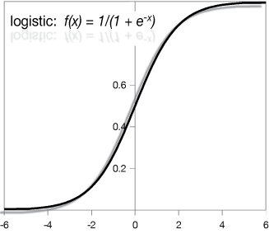

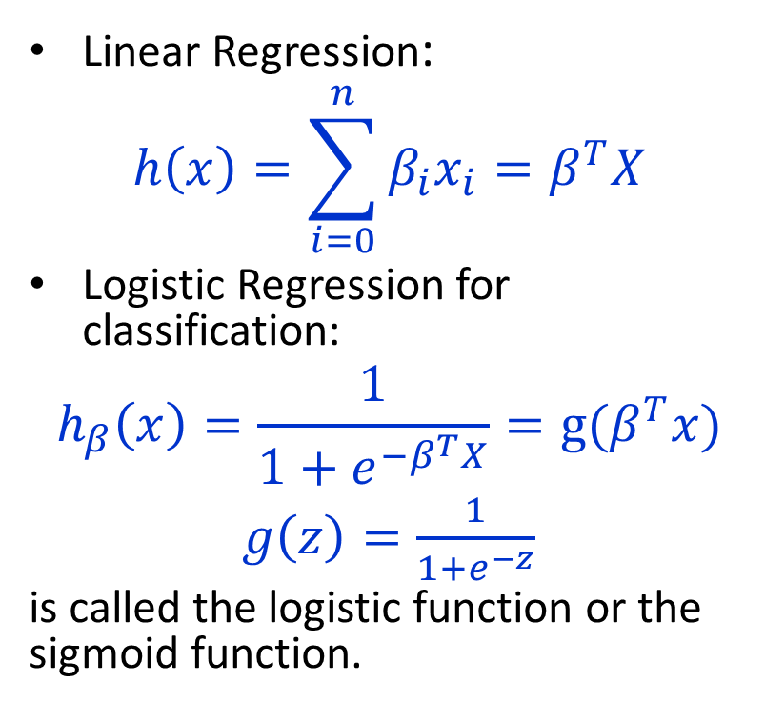
Logistic Regression for classification
Linear Regression:
$$h\left(x\right)=\sum_{i=0}^{n}{β_{i}x_{i}}=β^{T}X$$
Logistic Regression for classification:
$$h_{β}\left(x\right)=\frac{1}{1+e^{−β^{T}X}}=g(β^{T}x)$$
$g\left(z\right)=\frac{1}{1+e^{−z}}$
is called the logistic function or the sigmoid function.
Logistic:
$g\left(z\right)=\frac{1}{1+e^{−z}}$

Slide 7
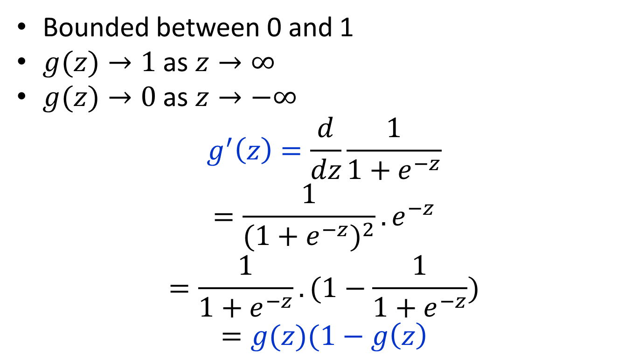
Sigmoid function properties
Bounded between 0 and 1
$g(z)→1$ as $z→∞$
$g(z)→0$ as $z→−∞$
$$g^{′}\left(z\right)=\frac{d}{dz}\frac{1}{1+e^{−z}}$$
$$=\frac{1}{{(1+e^{−z})}^{2}}.e^{−z}$$
$$=\frac{1}{1+e^{−z}}.(1−\frac{1}{1+e^{−z}})$$
$$=g(z)(1−g\left(z\right)$$

Slide 9
p is the probability that a club member fits into group 1. P(Y=1|X)

Slide 11
Examples of Odds Ratio

Slide 13
Interpreting output in R

